Slide 1

DESIGN AND SIMULATION OF AN ARITHMETIC LOGIC UNIT FOR PROCESSOR OPERATIONS
CSA1218-COMPUTER ARCHITECTURE
PROJECT BY
HEMANTH R (192521327)
DILIP KUMAR C (192412133)
SANTHOSH KUMAR M (192511017)
GUIDED BY
DR JAYASAKTHI VELMURUGAN K

Slide 2
INTRODUCTION
The project develops a web-based simulation of an 8-bit RISC processor with an Arithmetic Logic Unit (ALU).
The ALU performs essential arithmetic and logical operations such as ADD, SUB, MUL, DIV, AND, OR and XOR.
The system simulates processor execution through Instruction Memory, Instruction Decoder, Control Unit, Register File, ALU, Flags and Result Register.
Registers and operand values are automatically assigned by the system, while the user selects the required operation for execution.
The system analyzes processor performance by comparing execution time and operation results through graphical representation.

Slide 3
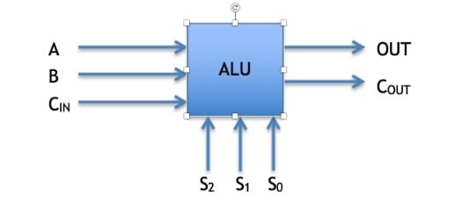
OBJECTIVE
To design and implement an 8-bit Arithmetic Logic Unit (ALU) capable of performing arithmetic and logical operations.
To simulate processor instruction execution through Instruction Memory, Instruction Decoder, Control Unit, Register File, ALU, Flags and Result Register.
To automatically assign registers and operand values during processor simulation while allowing the user to select the required ALU operation.
To generate and monitor processor results and flags after each executed operation.
To analyze processor performance graphically by comparing execution time and operation results.

Slide 4
PROBLEM STATEMENT
Understanding processor and ALU operations theoretically can be difficult without an interactive simulation environment.
Manual assignment of registers and operand values makes processor execution simulation less automatic and harder to demonstrate.
The interaction between the Control Unit, registers, ALU and flags needs to be clearly demonstrated during instruction execution.
Comparing different ALU operations based on execution performance is difficult without collecting and visualizing execution data.
Therefore, a web-based 8-bit RISC processor simulation is required to demonstrate ALU operations, automatic processor execution and graphical performance analysis in a simple interactive environment.

Slide 5
TOOLS AND TECHNOLOGIES USED
Python – Implements the core 8-bit RISC CPU architecture, ALU operations, register memory, and execution
timing.
Flask – Provides backend routing, template rendering, and RESTful APIs for simulation data.
HTML5 & CSS3 – Builds a responsive, modern dark-themed engineering interface with processor datapath
animations.
Vanilla JavaScript – Controls real-time datapath animations, 7-stage processor sequencing, and live flag updates.
Chart.js – Creates interactive graphical comparisons of execution time, computational complexity, and relative
efficiency.
VS Code – Used as the development environment for coding, testing, debugging, and project management.

Slide 6
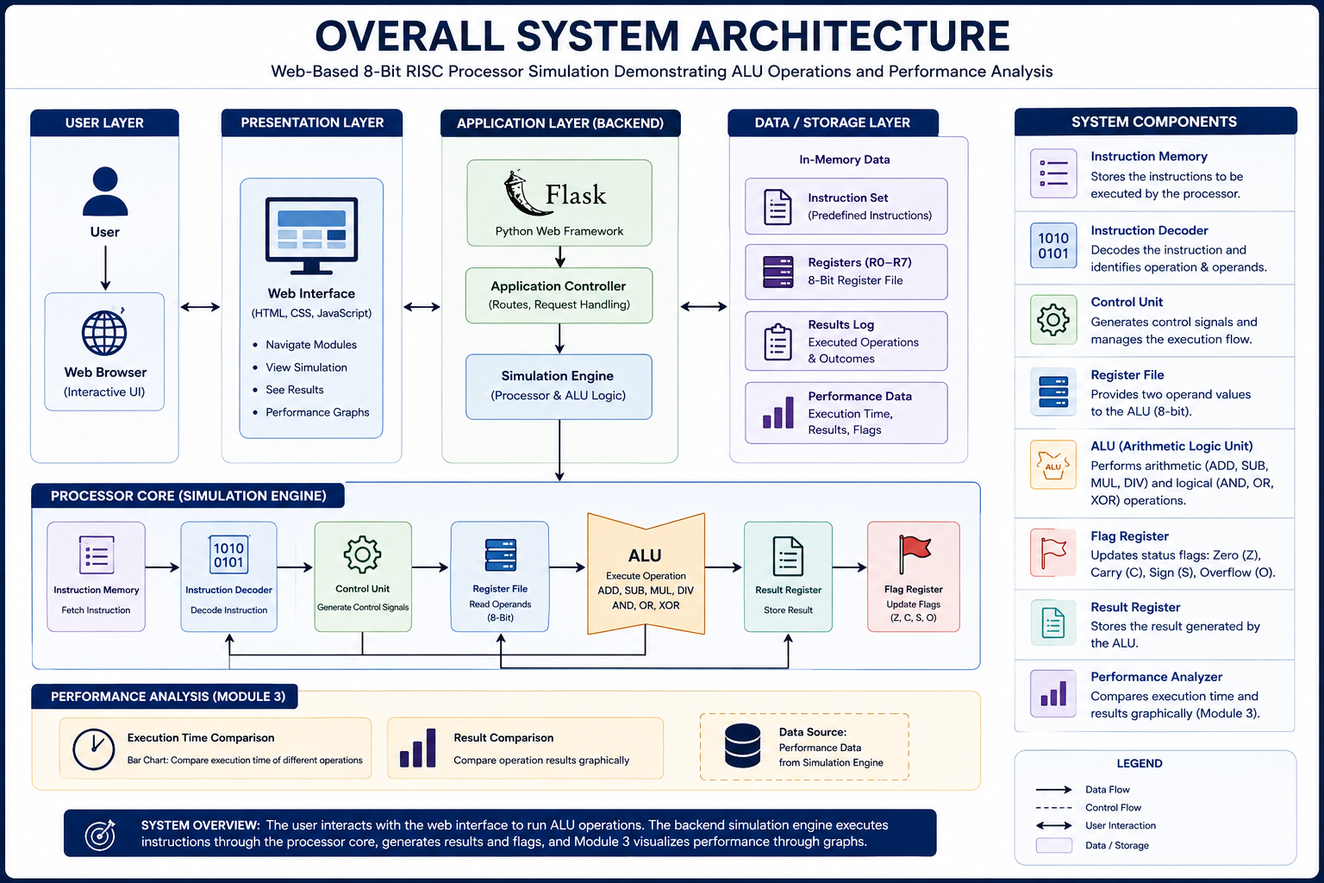

Slide 7
MODULE 1 : ALU FUNCTIONALITY
Explains the functional role of the 8-bit ALU in the processor.
Demonstrates arithmetic and logical operations performed by the ALU.
Processes two input operands and generates the corresponding output.
Shows how the ALU handles different operation types and results.
Demonstrates the generation of Zero, Carry, Negative, and Overflow flags.

Slide 8
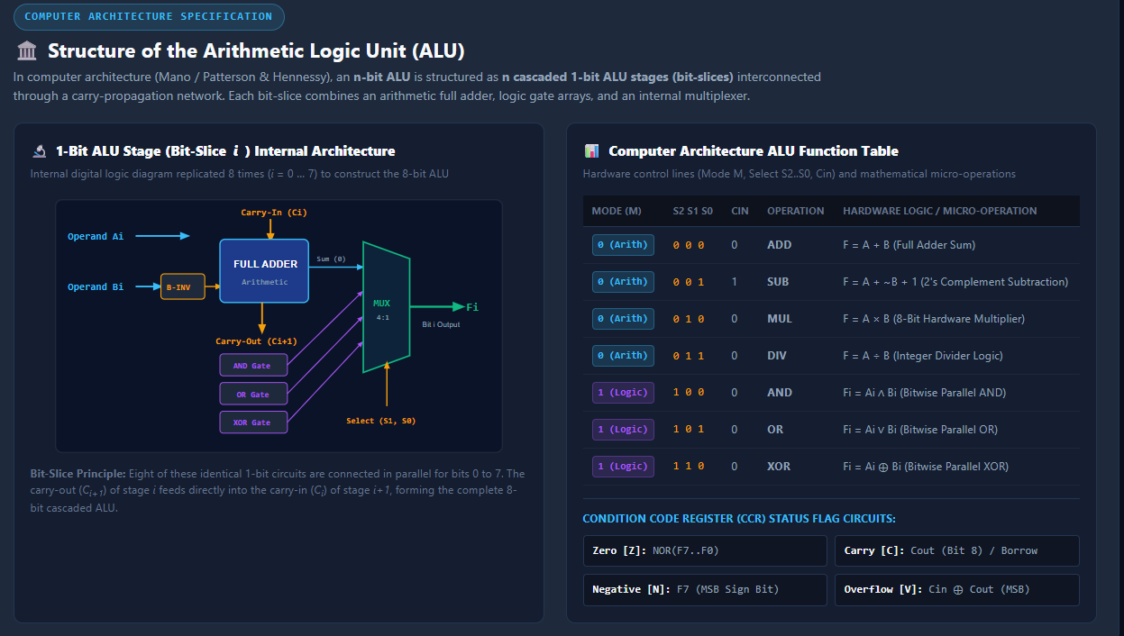

Slide 9
MODULE 2 : ALU SIMULATION
Simulates the execution of instructions in an 8-bit RISC processor.
The user selects the required ALU operation, while registers and operand values are automatically assigned by the system.
The Control Unit manages the execution flow from instruction fetching and decoding to register reading and ALU execution.
The ALU performs the selected arithmetic or logical operation and generates the result with processor flags.
The final result, execution details and execution time are recorded for further analysis in Module 3.

Slide 10
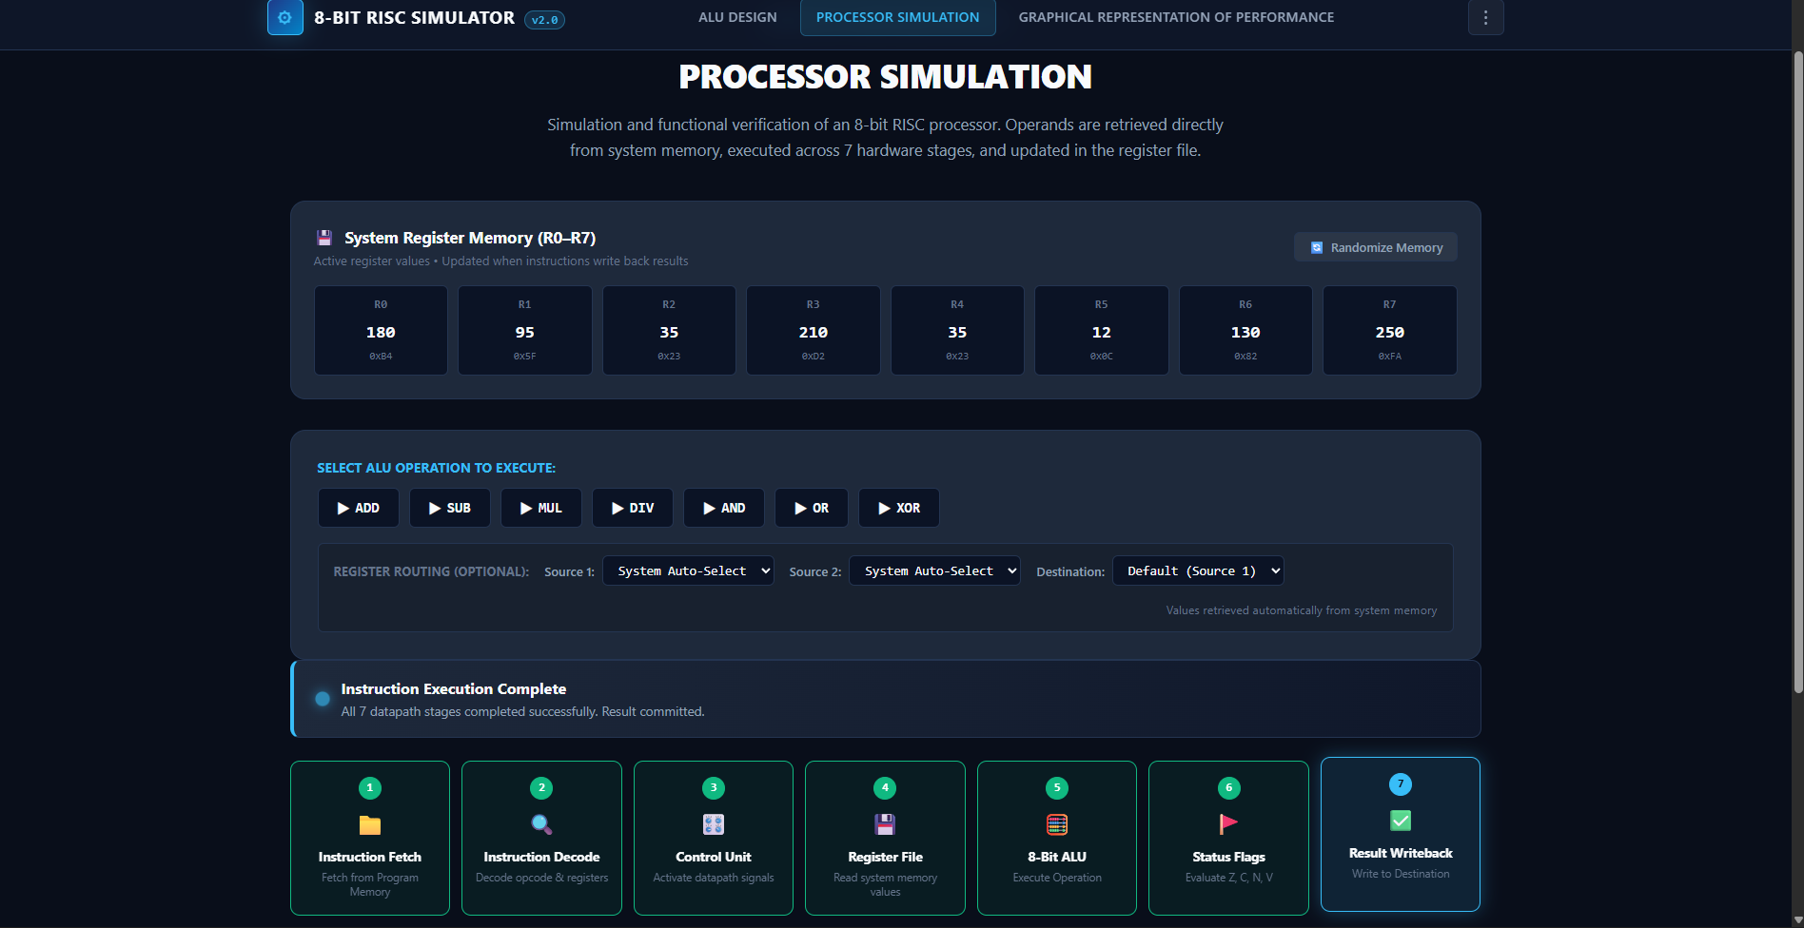

Slide 11
MODULE 3 :GRAPHICAL REPRESENTATION
Collects the execution data generated by the processor simulation for each completed ALU operation.
Compares the execution time of different operations using graphical representation.
Compares the calculated results of two selected ALU operations along with their operands and calculations.
Displays operation details such as registers, operand values, results and execution time for performance analysis.
Provides a visual comparison of processor operations, helping to understand differences in execution performance and ALU results.

Slide 12
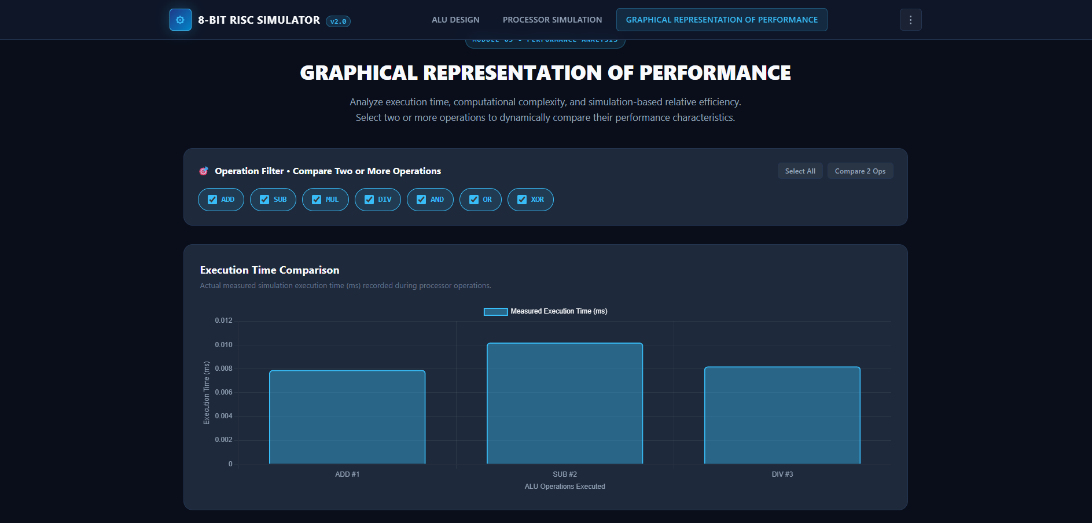

Slide 13
LIMITATIONS
Simulation-based: The project simulates processor and ALU operations rather than using a physical processor.
Limited instruction set: Only the implemented ALU operations such as ADD, SUB, MUL, DIV, AND, OR and XOR are supported.
8-bit processing: The simulation is designed for an 8-bit processor, so it does not represent larger processor architectures.
Simplified execution time: The measured execution time represents the software simulation and may not reflect the actual hardware execution time.
Limited processor features: Advanced features such as pipelining, cache memory, interrupts and multicore processing are not included.

Slide 14
FUTURE SCOPE
Expand the instruction set to support additional arithmetic, logical, data-transfer and control-flow instructions.
Increase processor size from 8-bit to 16-bit, 32-bit or 64-bit architectures.
Add advanced processor features such as pipelining, cache memory and interrupt handling.
Improve performance analysis by adding more detailed metrics and real-time graphical comparisons.
Develop a hardware implementation of the simulated ALU and processor for testing on FPGA or other digital hardware.

Slide 15

CONCLUSION
Successfully developed a web-based 8-bit RISC-style processor simulation with an integrated ALU.
Implemented arithmetic and logical ALU operations with automatic register and operand assignment.
Demonstrated the complete processor execution flow from instruction selection to result and flag generation.
Provided graphical analysis of execution time and operation results for performance comparison.
The project provides an interactive and practical way to understand ALU functionality and processor instruction execution.

Slide 16
REFERENCES
David A. Patterson and John L. Hennessy, Computer Organization and Design: The Hardware/Software Interface, Morgan Kaufmann.
William Stallings, Computer Organization and Architecture: Designing for Performance, Pearson.
M. Morris Mano, Computer System Architecture, Pearson.
Python Documentation — Python programming language and standard library.
Flask Documentation — Flask web application framework.
Chart.js Documentation — JavaScript library used for graphical data visualization.

